Slide 1
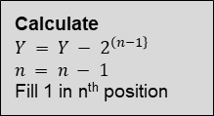


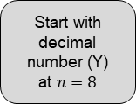

Start with decimal number (Y) at $n=8$
Yes
Is $Y$ less than $2^{\left(n−1\right\}}$?
No
Calculate
$Y = Y − 2^{\left(n−1\right\}}$
$$n = n − 1$$
Fill 1 in n^{th} position
Fill 0 in n^{th} position
$$n = n − 1$$
No
Is $n<1$?
Yes
End

Slide 2
